Slide 1

Predictive Analytics in Business (BUAN 448–R & RStudio)
BUAN 448 – Fall 2022 – Dr. Davoodi

Slide 2
Agenda
Welcome to R
Use R with RStudio
Using Rmarkdown, R Project, R Scripts
R Basics
Objects, Names, Variables, Functions,
Vectors, Scalars, Arrays and Matrix, Data Frame
Install R Packages and Load a Library
Review of R Commands and Functions
Get Data into R
Save your directory

Slide 3
Welcome to R!
Introduction to R

Slide 4
What is R?
R is a programming language.
It is not a “statistics program” like SPSS or Minitab.
The official R Project describes R as “a language and environment for statistical computing and graphics”.
R is a great programming language for doing statistics.

Slide 5
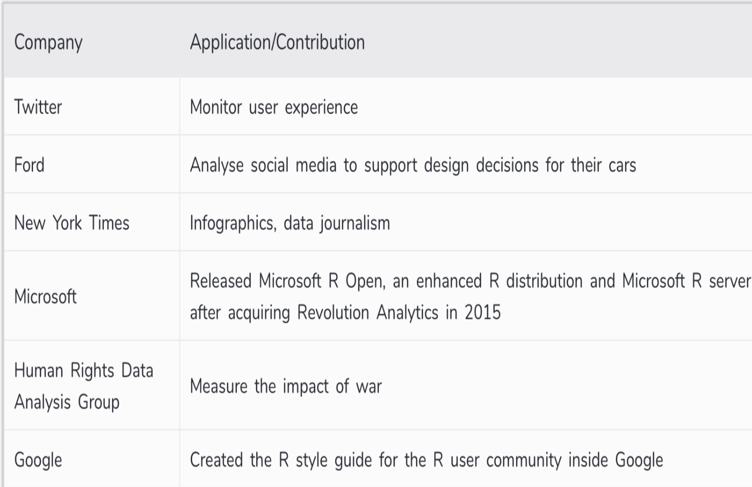
Who uses R and Why to learn R?
R is being used by the biggest Tech giants
R skills are in very high demand
Learning R will increase your chances of getting a job!
https://www.datamentor.io/r-programming/

Slide 6
Why R?
For analysts, R offers the largest and most diverse set of analytic tools and statistical methods.
R offers beautiful and powerful plotting functions that are able to produce graphics vastly more tailored and informative than typical spreadsheet charts.
Open source (Free!)
15,000 Add-on Packages

Slide 7
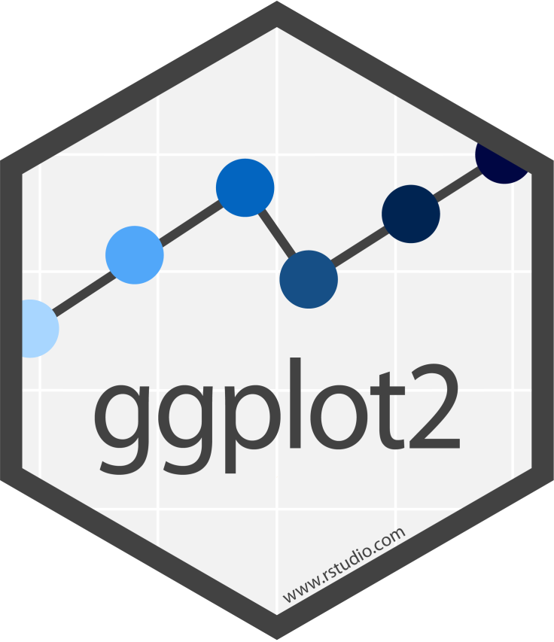

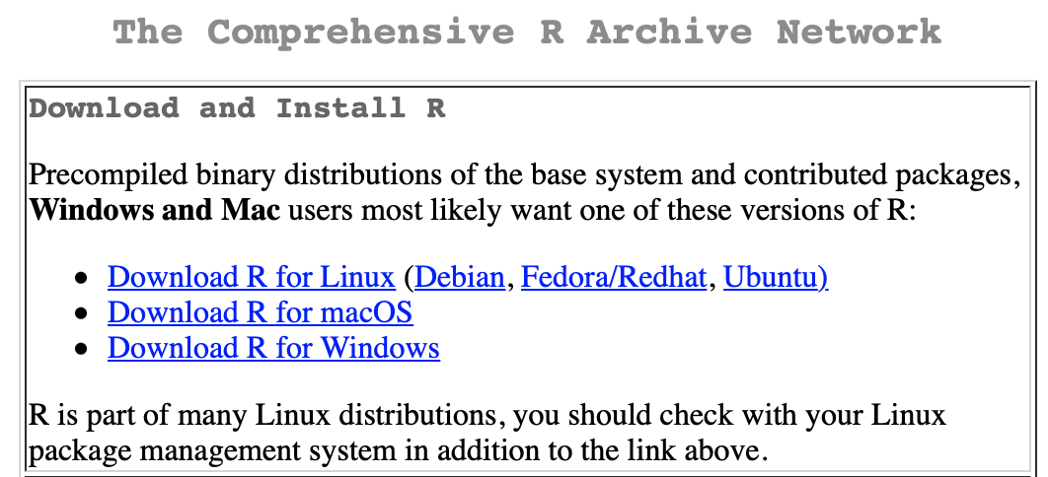
Install R
Install R:
Download the appropriate version of R:
https://cran.rstudio.com/
Run the package

Slide 8

Use R with RStudio
R itself is a relatively small application with next to no user interface. Everything works through a command line or console.
At its most basic, you launch it from your Terminal application (on a Mac) or Command Prompt (on Windows) by typing R.
We can make life easier for ourselves by using RStudio.
RStudio is an “integrated development environment,” or IDE.
It is a separate application from R proper.

Slide 9
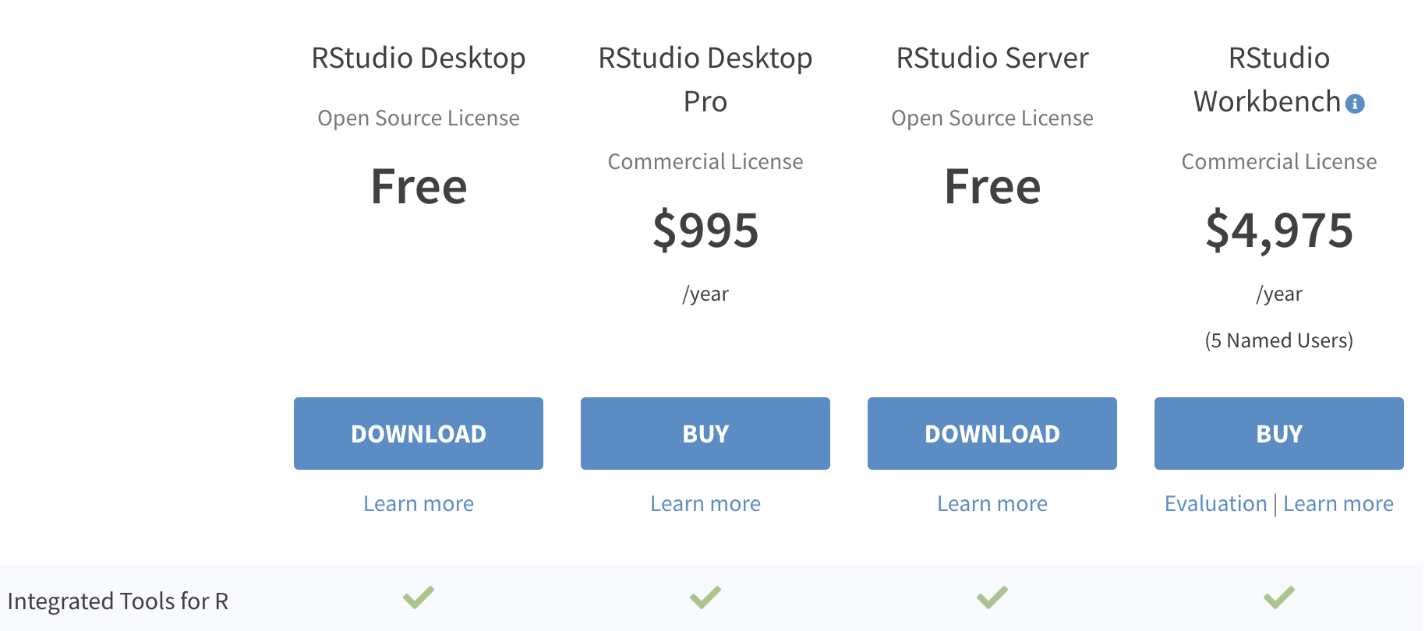
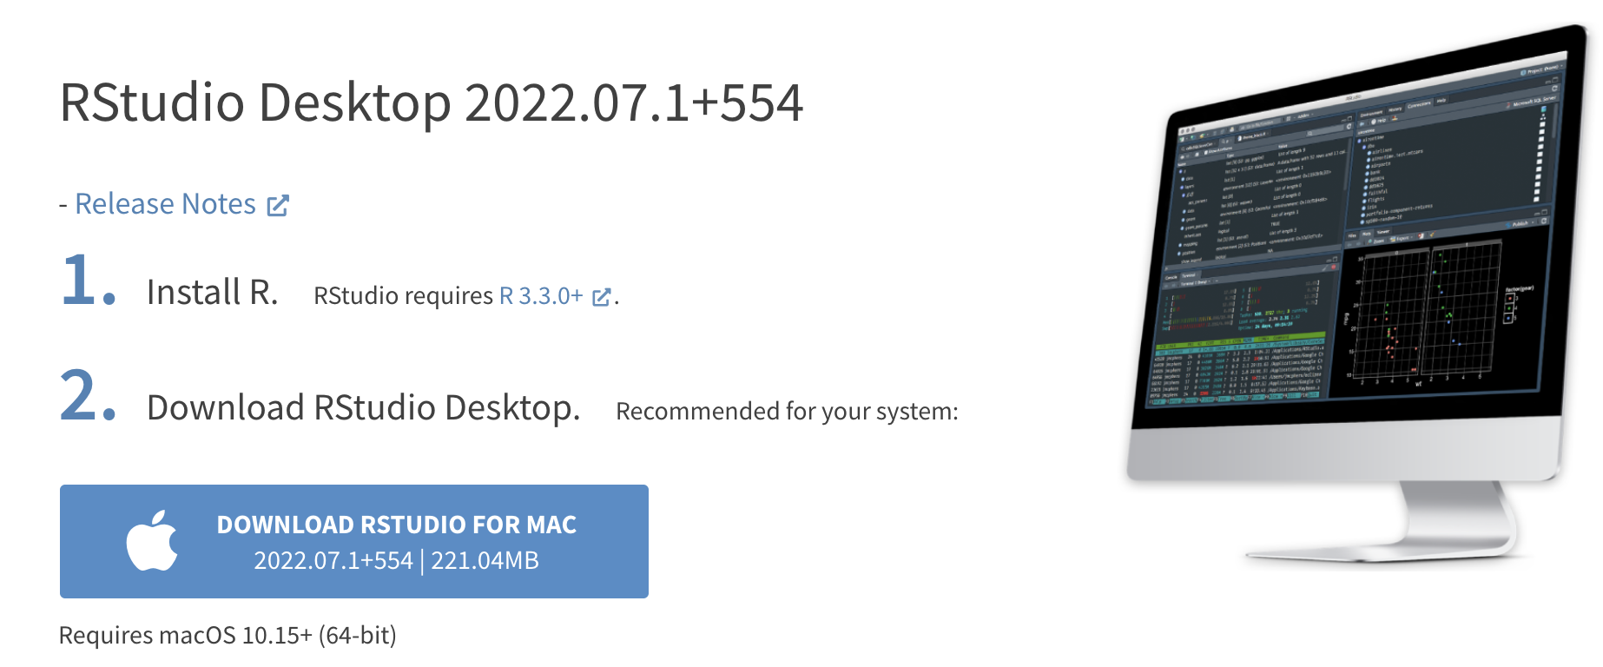
Install RStudio
Download the RStudio IDE: Choose Your Version
https://www.rstudio.com/products/rstudio/download/

Slide 10
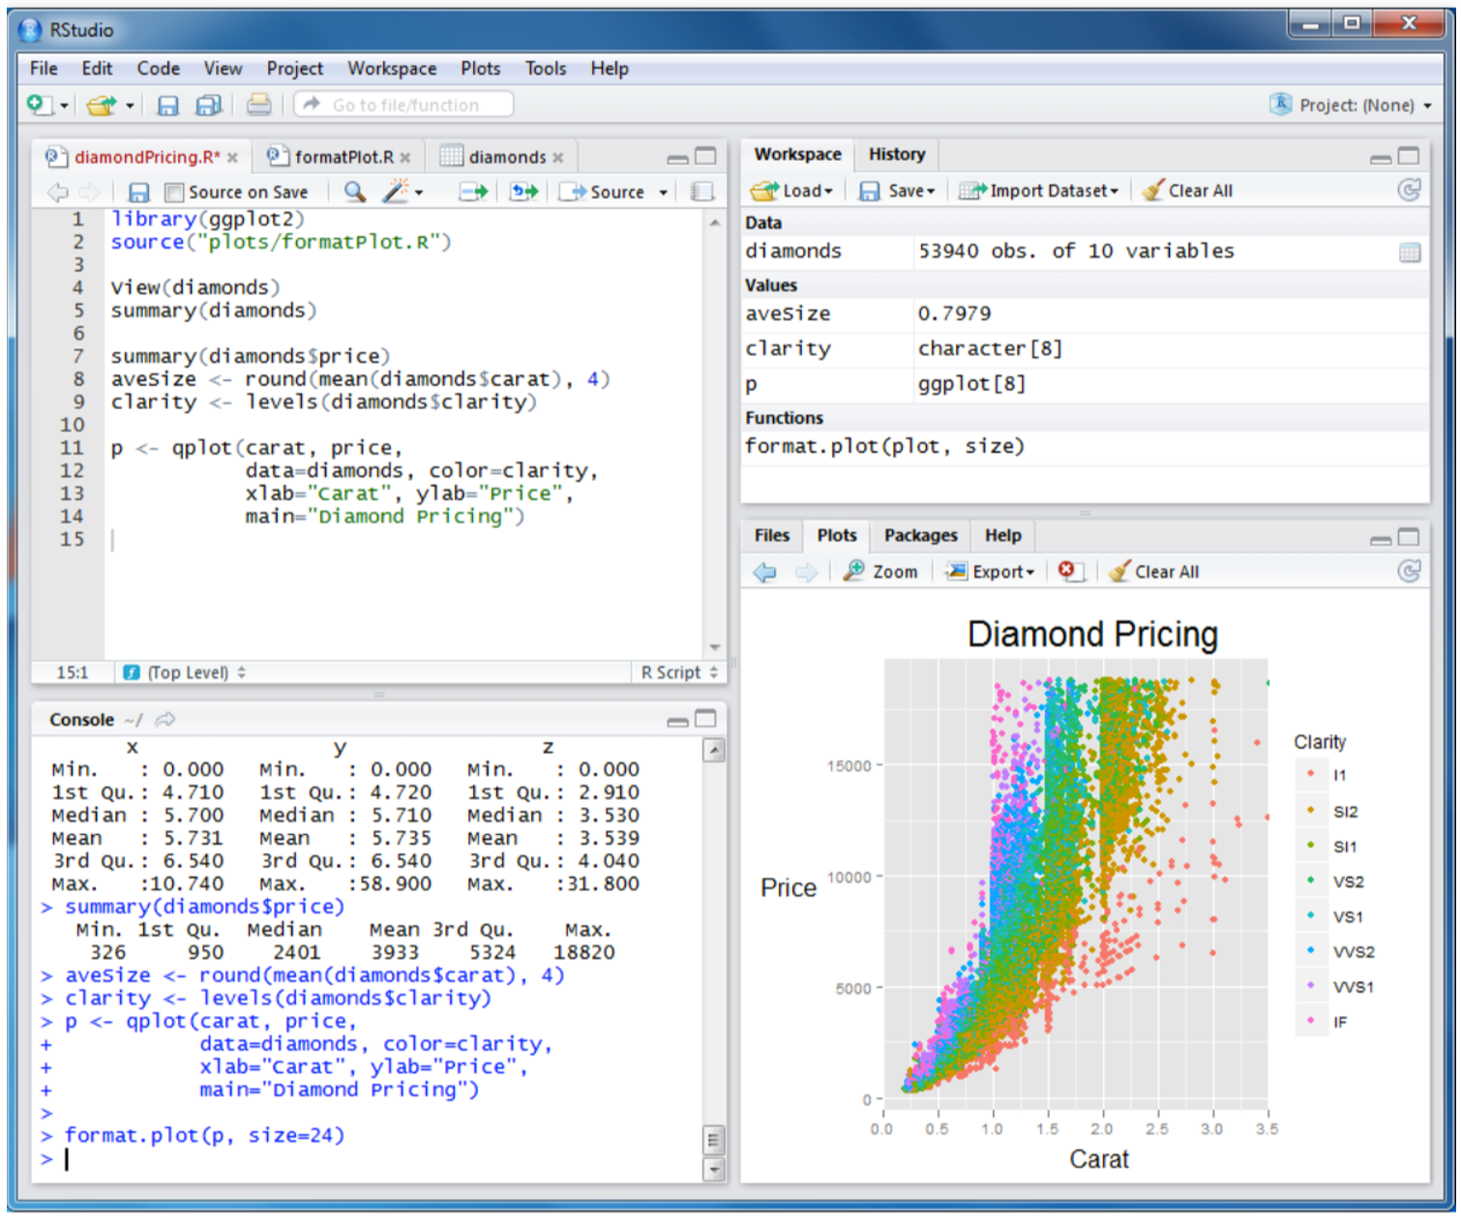
R Studio: 4 Main Windows (‘Panes’)
Workspace/History
Source
Console
Files/Plots/Packages/Help

Slide 11
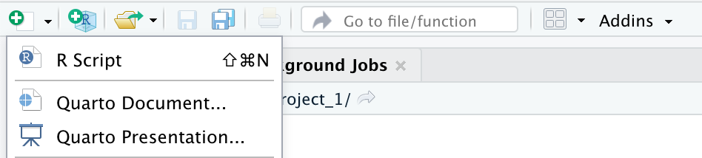
Work with an R Script File
You can create a draft of your code as you go by using an R script.
An R script is just a plain text file that you save R code in.
R script files conventionally have the extension .r or .R.
You can create an r script via File > New File > R Script.

Slide 12
R Basics
Review R commands and functions

Slide 13
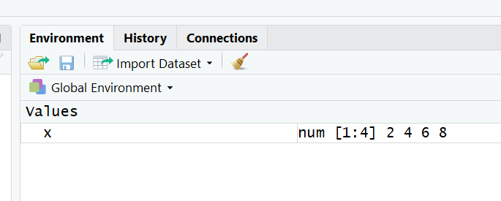
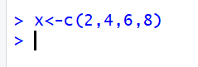
Create an object x
Let’s try: > x <- c (2, 4, 6, 8) followed by the Enter key
This is a simple assignment command using the assignment operator “<-” to create a named object x that comprises a vector of numbers, (2, 4, 6, 8).
The assignment operator can be pronounced as “gets” and is the way to assign values to R variables (“objects”).

Slide 14
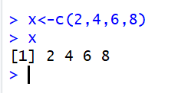
Create an object x
For some commands, R responds by printing something in the console.
For example, when you type the name of a variable into the console like this: > x
R responds by printing out the value of x. In this case, we define x above as a vector of numbers.

Slide 15
Assignment
All R statements where you create objects, assignment statements, have the same form:
object_name <- value
When reading that code say “object name gets value” in your head.
You will make lots of assignments and <- is a pain to type.
Don’t be lazy and use =
(= will work, but it will cause confusion later)
Instead, use RStudio’s keyboard shortcut: Alt - (the minus sign).
Notice that RStudio automagically surrounds <- with spaces, which is a good code formatting practice.

Slide 16
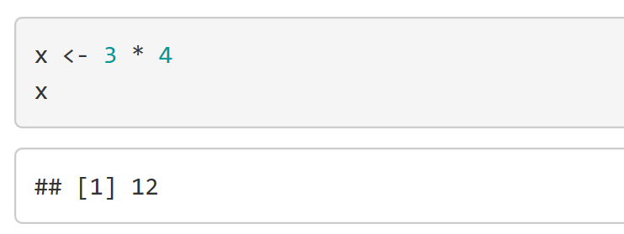
What’s in a name?
Object names must start with a letter, and can only contain letters, numbers, _ and .
For example: snake_case (separate lowercase words with _ )
You can inspect an object by typing its name:
R is picky and is case sensitive!
Open “R basics” R Script.

Slide 17
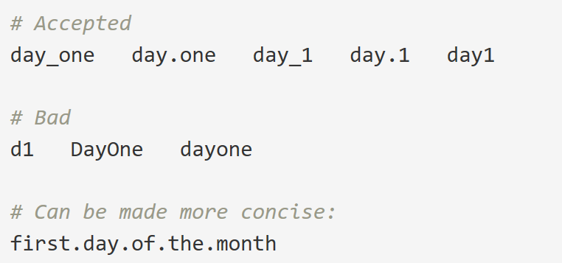
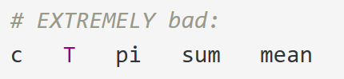
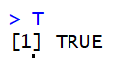
Enforced style: Variable names
To make code easy to read, debug, and maintain, you should use concise but descriptive variable names
Terms in variable names should be separated by _ or .
Avoid using variable names that are already pre-defined in R

Slide 18
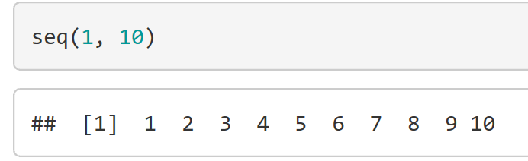
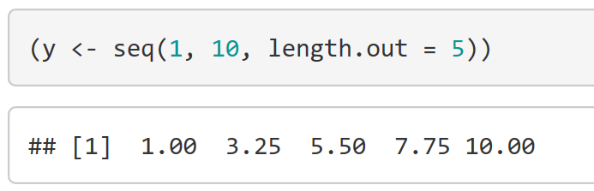
Calling functions
R has a large collection of built-in functions that are called like this: function_name(arg1 = val1, arg2 = val2, ...)
Example: Let’s try using seq() which makes regular sequences of numbers:
You can look at your environment in the upper right pane to see all objects that have been created.

Slide 19
Calling functions
You can look at your environment in the upper right pane to see all objects that have been created.

Slide 20
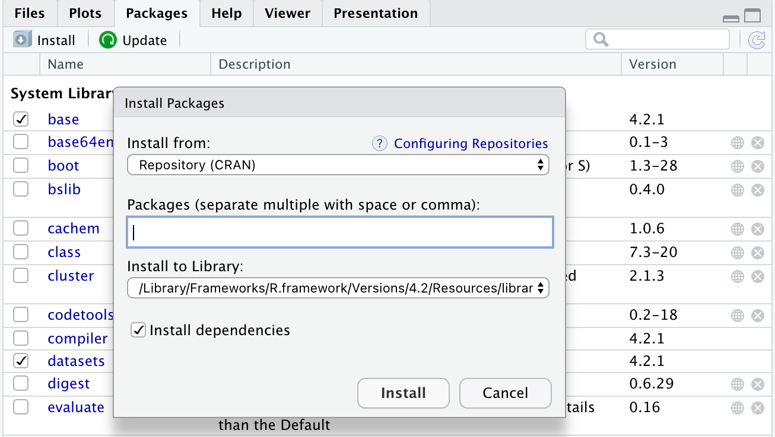
R Packages
Packages are the fundamental units of reproducible R code. They include reusable R functions, documentation that describes how to use them, and sample data.
Available CRAN Packages By Name: https://cran.r-project.org/web/packages/available_packages_by_name.html
Installing Packages
Open RStudio.
In the lower-right pane of RStudio, select the Packages tab and the Install button.
Type the name of the packages to be installed in the “Packages”.
Press Install.

Slide 21
R Packages
Example of Multiple Installation
"tidyverse", "broom", "coefplot", "cowplot", "drat",
"gapminder", "GGally", "ggrepel", "ggridges", "gridExtra",
"here", "interplot", "margins", "maps", "mapproj",
"mapdata", "MASS", "quantreg", "rlang", "scales", "socviz",
"survey", "srvyr", "viridis", "viridisLite", "devtools",
"rtools","backports","vctrs"
The following are the packages Healy habitually loads into memory for each chapter:
library(gapminder)
library(here)
library(tidyverse)
library(socviz)

Slide 22
Vectors, Scalars, Arrays and Matrix
Vectors are variables with one or more values of the same type.
A variable with a single value is known as scalar. In R a scalar is a vector of length 1.
Arrays are numeric objects with dimension attributes.
A matrix is a two-dimensional array.
The difference between a matrix and an array is that arrays have more than two dimensions.

Slide 23
Data Frames
Data scientists work mostly with data frames.
You can build data frames in R or import data frames into R.

Slide 24
Objects in R

Slide 25
String Characters
In R, string variables are defined by double quotation marks.
> letters
[1] "a" "b" "c"
Notes:
In this slide. Go to R code and practice creating objects and vectors.

Slide 26
Subscripts and Indices
To select only one or some of the elements in a vector, a matrix or an array, use subscripts in square brackets [ ].
In matrices or data frames the first subscript refers to the row and the second to the column.

Slide 27
Review of R Commands and Functions
Function | Purpose | Example
c() | Enter data manually to a vector | > x <- c(8, 6, 7, 5, 3, 0, 9) > x [1] 8 6 7 5 3 0 9
seq() | Generate regular sequences | > y <- seq(7, 30, 1.5) > y [1] 7.0 8.5 10.0 11.5 13.0 14.5 16.0 17.5 19.0 20.5 22.0 23.5 25.0 26.5 28.0 29.5
rep() | Replicates numeric values, or text, or the values of a vector for a specific number of times. | > hDeck <- c(rep(1, 5), rep(0, 3)) > hDeck [1] 1 1 1 1 1 0 0 0
ls() | Lists memory contents
rm() | Removes an item from memory

Slide 28
Review of R Commands and Functions
Function | Purpose | Example
data() | Load (often into a data.frame) built-in dataset | > data(iris)
names() | Lists names of variables in a data.frame | > names(iris) [1] "Sepal.Length" "Sepal.Width" "Petal.Length" "Petal.Width" "Species"
View() | View dataset in a spreadsheet-type format
dim() | See dimensions (# of rows/cols) of data.frame | > dim(iris) [1] 150 5
length() | Give length of a vector
read.csv() | Load into a data.frame an existing data file
read.table() |  | read.table(filename,header=TRUE)

Slide 29
Review of R Commands and Functions
Function | Purpose | Example
apply() | Apply function by rows or columns of a data frame or a matrix | #Using apply to find row sums: > apply(my.matrx, 1, sum) #Using apply to find length of each column: > apply(my.matrx, 2, length)
lapply() | Apply function by rows or columns of a list and returns a list
sapply() | takes list, vector or data frame as input and gives output in vector or matrix
as.data.frame() | check if an object is a data frame, or coerce it to a data frame if possible
as.double() | Convert integer to double class.

Slide 30
Review of R Commands and Functions
Function | Purpose | Example
all() | Check whether all values of a logical vector are TRUE | > x1 <- c(1, 5, 3, - 3, 5, - 7, 8) > all(x1 < 0) [1] FALSE
any() | Check whether any values of a logical vector are TRUE | > any(x1 < 0) [1] TRUE
is.data.frame () | Test if object is a data frame
sort() | Return input in ascending or descending order | > x <- c(4, - 10, 8, 0) > sort(x) [1] -10 0 4 8
write() | Write data to files
write.xlsx() | Export data frame from R to Excel workbook. | > write.xlsx(data, "data.xlsx")

Slide 31
Review of R Commands and Functions (Statistical)
Function | Purpose | Example
summery() | Display 5-number summary and mean: Min, 1st Quartile, Median, Mean, 3rd Quartile, Max. | > summary(x)
mean() | Identify “center” of distribution | > mean(x, na.rm = FALSE) ** na.rm is used to remove the missing values from the input vector.
median() |  | > median(x, na.rm = TRUE)
var() | Find variance, the standard deviation of values in a vector | > var(x)
sd() |  | > sd(x)
sum() | Add up all values in a vector
quartile() | Find the position of a quantile in a dataset | >quantile(x, probs=seq(0, 1, .2), na.rm=T) ** na.rm is used to remove the missing values from the input vector. **probs: numeric vector of probabilities with values in [0,1]: 0% 20% 40% 60% 80% 100%

Slide 32
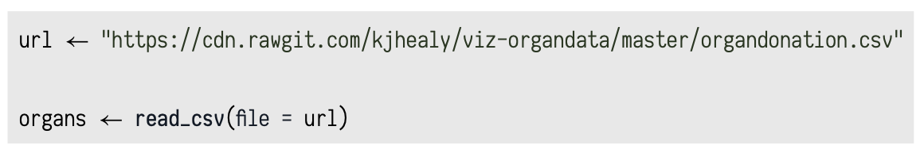
Get Data into R
Use the read_csv() function to read in “comma-separated” data.
This function is in the readr package, one of the pieces of the tidyverse.
Note: The "tidyverse" collects some of the most versatile R packages: ggplot2, dplyr, tidyr, readr, purrr, and tibble. The packages work in harmony to clean, process, model, and visualize data.
Example: We can tell read_csv() to fetch data for us from an URL and put it in an object named organs:

Slide 33
.RData file
To save your workspace as a .RData file, you can run save.image().
save.image("Week1_part1.RData")

Slide 34
Summary
Installing R and using R with RStudio
Review some R commands and functions
Read data and save our workspace.

